Slide 1
Dan Birman
2016-02-16
Frisem

Slide 2
What is it like to be a monkey?

Slide 3
What is it like to be a monkey?
prospective student

Slide 4
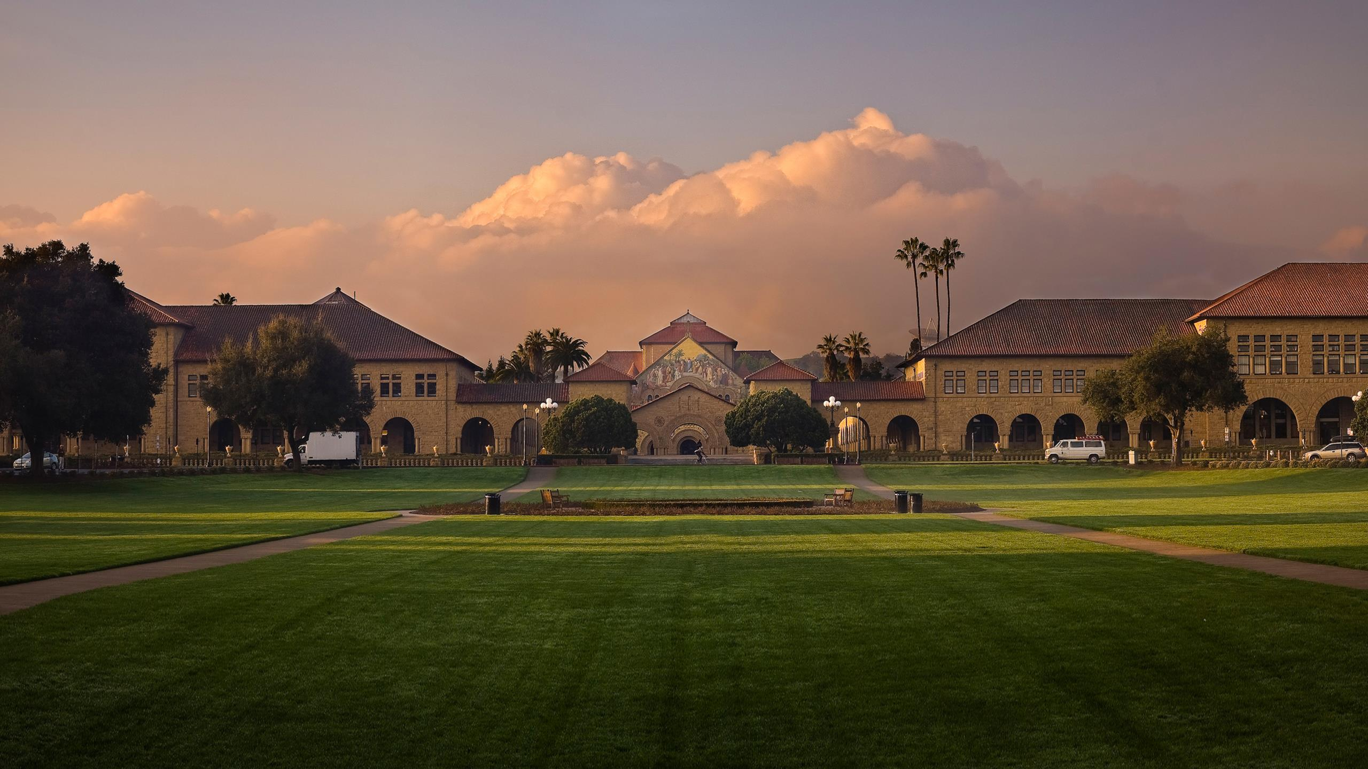

Slide 5
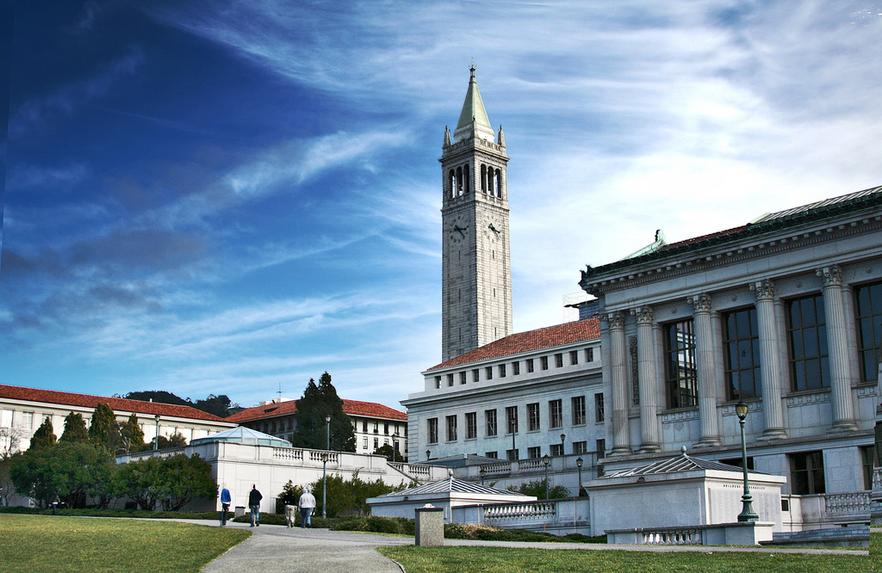

Slide 6


Same?
Different?

Slide 7
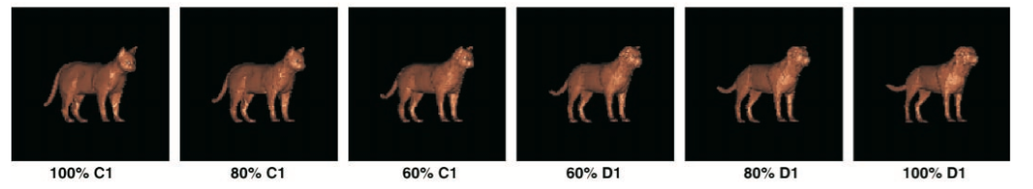
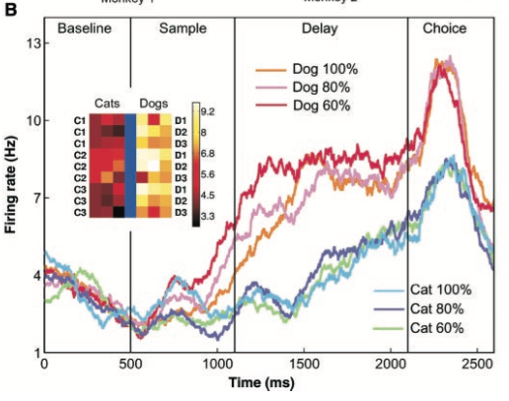
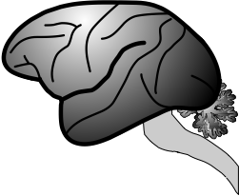
Freedman DJ, Riesenhuber M, Poggio T, Miller EK (2001) Categorical representation of visual stimuli in the primate prefrontal cortex. Science 291:312–316.

Slide 8
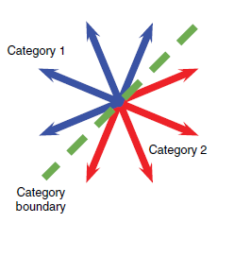
Sarma et al. 2016

Slide 9
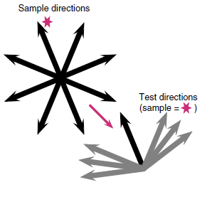
Sarma et al. 2016

Slide 10
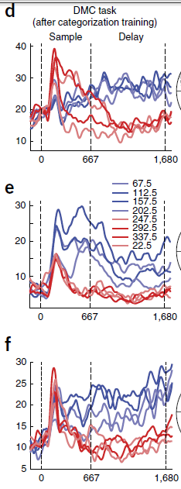

Slide 11
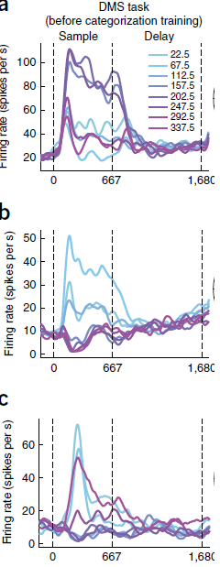

Slide 13
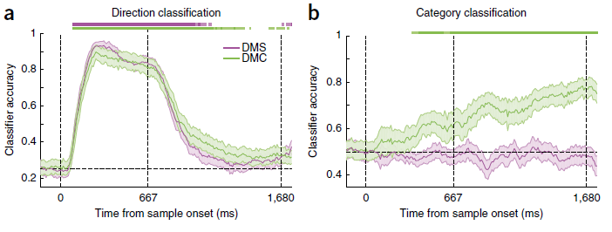

Slide 14
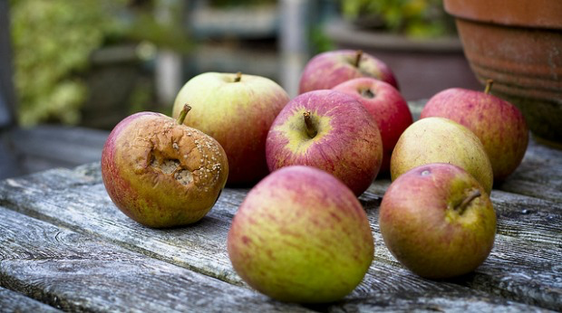
Sarma et al. 2016

Slide 15
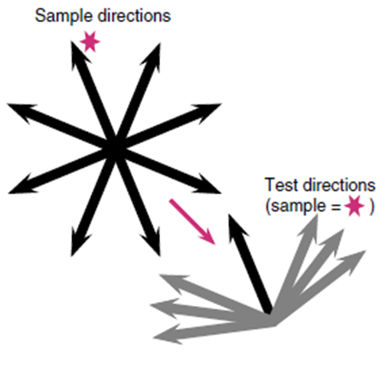


Sarma et al. 2016

Slide 16
So, what is it like to be a
monkey?

Slide 17
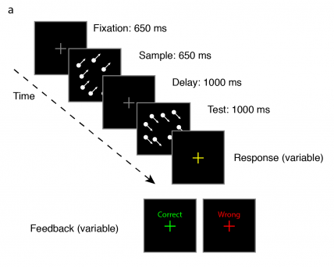

Slide 18
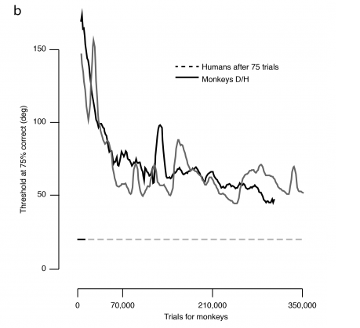

Slide 20
Same
???
60% diff
Different!

Slide 21
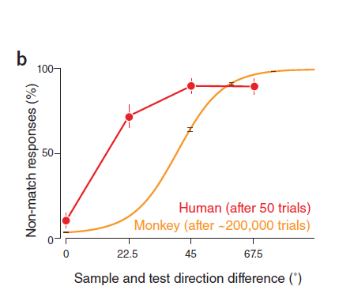
Same
???
60% diff
Different!

